Slide 1
Smart Bookstand
Project Design

Slide 2
Ideas behind the “Smart Bookstand”
“Your reading experience should be more than a simple woodblock”
“No bookstand has a decent lighting system embedded within”
“Why can’t bookstands be portable?”

Slide 3
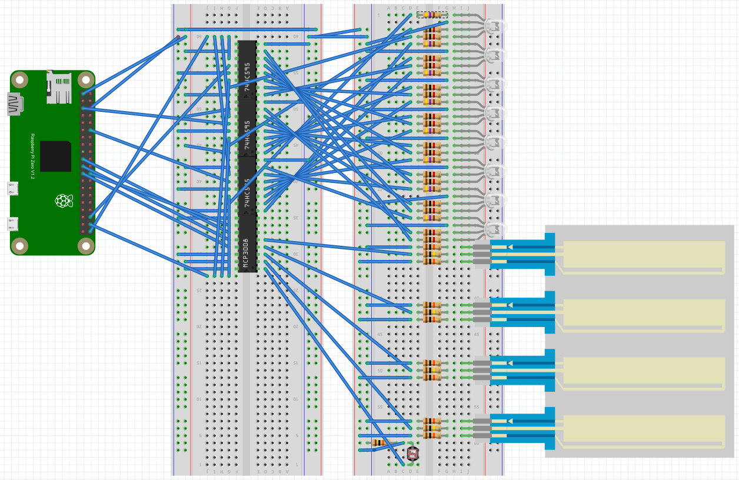
Overview <Fritzing>

Slide 4
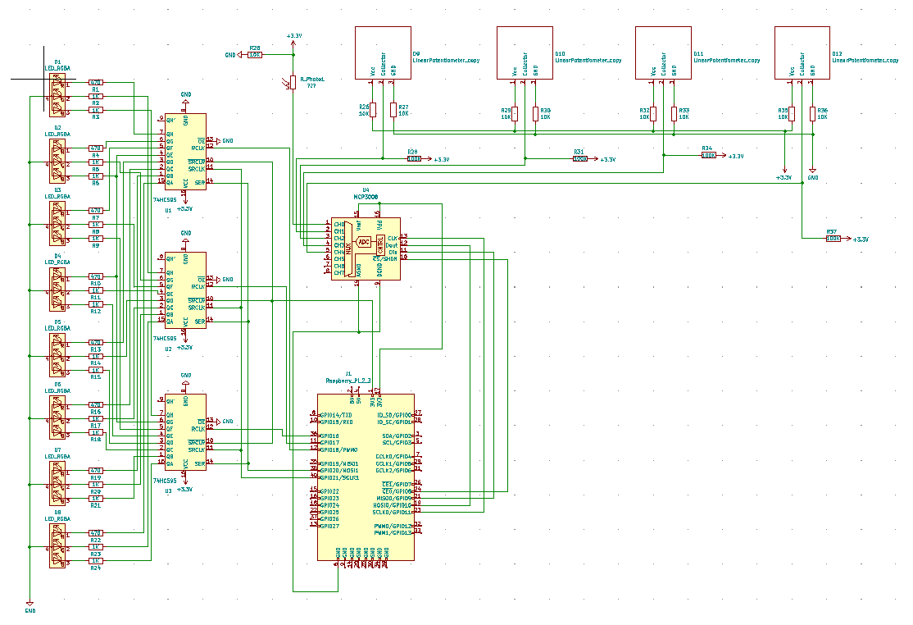
Overview <KiCAD>

Slide 5
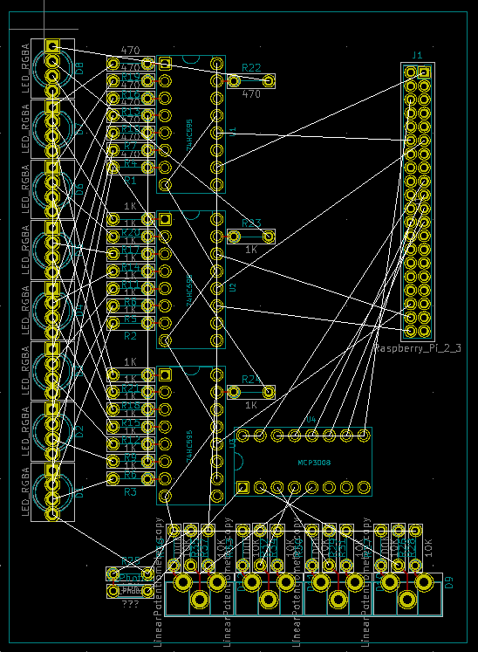
Overview KiCAD PCB Design

Slide 6

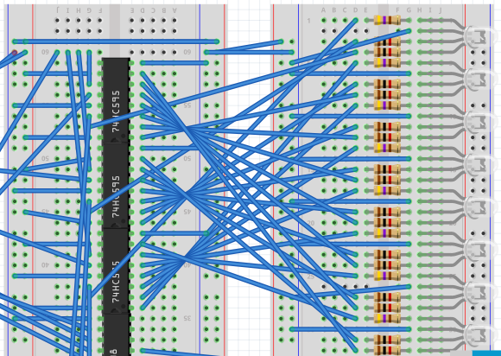
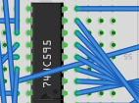
Lighting system - Fritzing
R
GND
RGB LEDs – 8 of them
Each with a current limiting resistor
Red -> connected using 470Ω
Green / Blue -> 1kΩ
74HC595 Shift Register
One for each color – 3 total
8 outputs connected to each LED
Will be connected to SPI1, 3CEs
G
B
I know its dizzy – Let’s go into the details

Slide 7
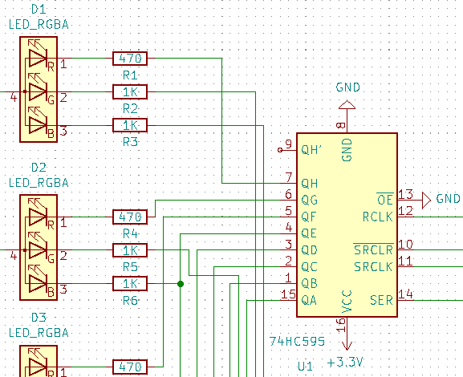
Lighting system - KiCAD

Slide 8
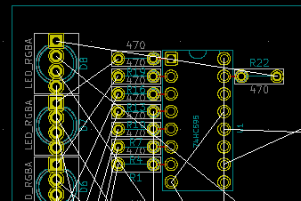
Lighting System KiCAD PCB Design

Slide 9
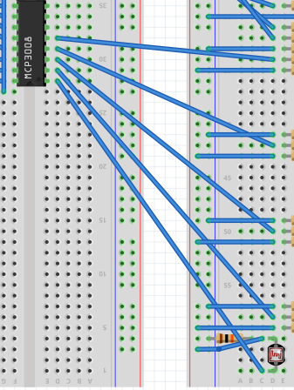
Photoresistor - Fritzing
Resistor value changes as the incoming light level varies.
Pull down resistor of 10kΩ
Connected to channel 0 of MCP3008
MCP3008 operates through SPI0

Slide 10
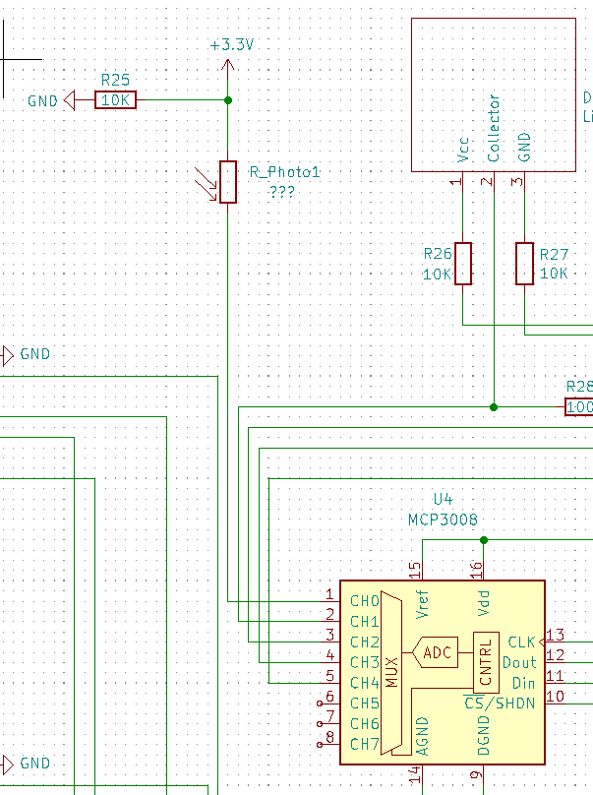
Photoresistor - KiCAD

Slide 11
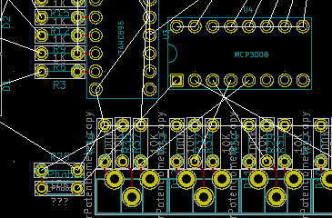
Photoresistor KiCAD PDB Design

Slide 12

Linear Potentiometer - Fritzing
A varying resistor:
Depending on where you touch
Using current limiting resistors – 10k on Vcc and GND
100k as a pullup resistor on Collector
Closer to the collector, the smaller the resistor value
4 in total - Connected to channel 1-4 of MCP3008
GND
Collector
Vcc
Fritzing diagram taken from following:
https://github.com/sparkfun/Fritzing_Parts/blob/master/products/08680_softpot_membrane_potentiometer_50mm.fzpz

Slide 13
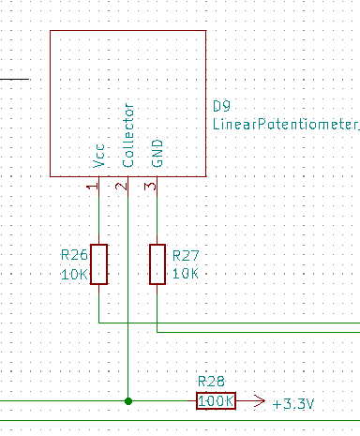
Linear Potentiometer - KiCAD
Diagram Manually Created

Slide 14
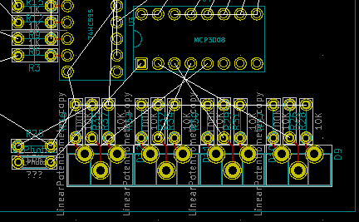
Linear Potentiometer KiCAD PCB Design

Slide 15
Thank you
End of Document

